Slide 1
Development of Japanese Shinkansen and SCMAGLEV
IHRA Vice Chairman
Torkel Patterson
July 2, 2021

Slide 2
Agenda
Part1: How Shinkansen have transformed Japanese railways
Part2: The impact Shinkansen has had on economic growth in urban areas
Part3: The technological investments being made by JR Central to
commercialize the SCMAGLEV between Tokyo and Osaka.
Part4: The technical improvement of Shinkansen since 1964

Slide 3
Part1: How Shinkansen have transformed Japanese railways
1. As a catalyst for economic and societal transformation by solving existing
transport capability problems (safety, frequency, capacity, reliability) on trunk
lines between major urban regions
→ Present example; Tokaido Shinkansen (Tokyo-Osaka)
→ Future example; SCMAGLEV
- technological developments, speed through SCMAGLEV, national
economic security as a by-pass of the Tokaido Shinkansen
2. By expanding nationwide economic growth through improving passenger
mobility along economically developed national axes
→ ex) Sanyo Shinkansen (Osaka-Hakata), Tohoku Shinkansen (Tokyo-Sendai) ,
Joetsu (Tokyo-Niigata) Shinkansen
3. Promoting regional vitality in remote areas by improving accessibility to/from
major population centers
→ ex) Tohoku Shinkansen (Sendai~Shin-Aomori), Kyushu, Hokuriku, Hokkaido Shinkansen

Slide 4
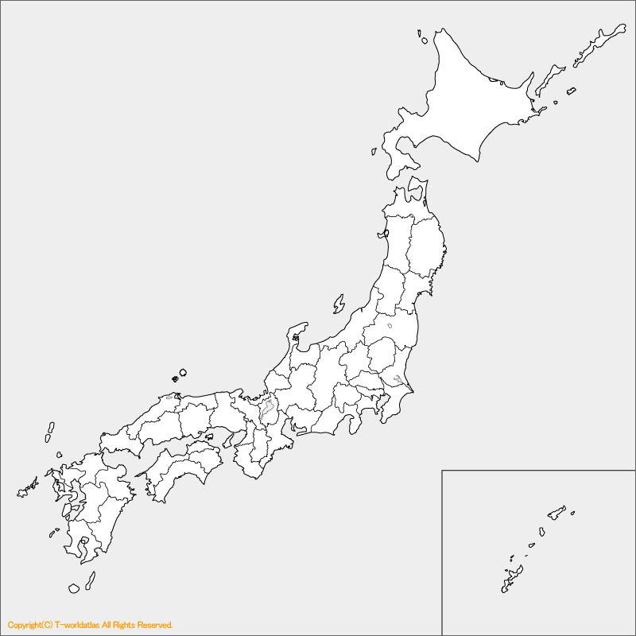
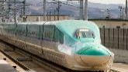
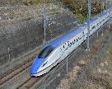
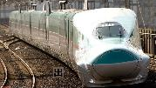
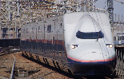

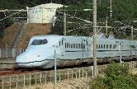

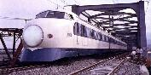
Hokuriku S. u.c.
Hokkaido S.
u.c. (till Hakodate 2016)
Sapporo
Developed national axes
Trunk Line
Improving access availability
Introduced with
(a) Dedicated track
(b) Automatic Train Control (ATC) System
Tohoku S. 2011
(till Hachinohe 2002)
Joetsu S. 1982
Hokuriku S.
(till Kanazawa 2015)
(till Osaka; u.c.)
Sendai
Niigata
Tohoku S. 1982
Kanazawa
Nagoya
Tokyo
Chuo S. u.c.
Hiroshima
Osaka
Superconducting Maglev
Hakata
Tokaido S. 1964
Development of HSR Network in Japan
Sanyo S. 1975
Nagasaki
Kyushu S. 2011 (South-most part 2004)
u.c. (West)
Kagoshima-Chuo

Slide 5
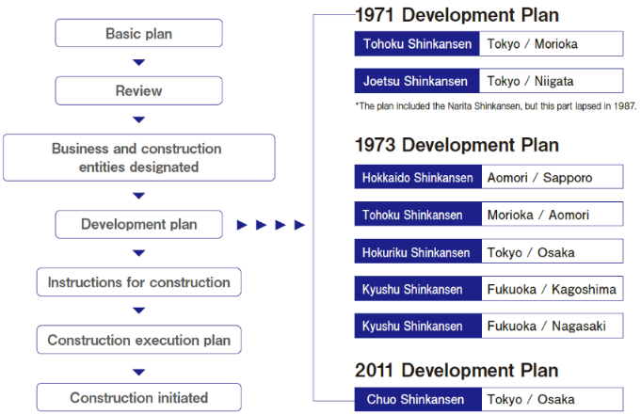
National long-term plan with a clear goal
With the success of the Tokaido Shinkansen, its safety, high-speed, and convenience widely supported
by the public, and Japanese government planned to expand the construction of the Shinkansen nationwide
Nationwide Shinkansen Railway Development Act (1970)

Slide 6
Part2: The impact Shinkansen has had on economic growth in urban areas
Daily passengers
(FY 2019/ per day)
Started with 12 stations in 1964 and later built 5 new stations.
: Limited Express “Nozomi”
: Limited Express “Hikari”
: Limited Express “Kodama”
: All trains will stop
: Some trains will stop
: No train will stop
*Nozomi stations: stations which Nozomi Express stops
(Tokyo, Shinagawa, Nagoya, Kyoto, Shin-Osaka)
1964
1964
1964
1964
1964
1988
1964
1964
1988
1964
1988
1969
1964
1964
1964
2003
1964
Connects to Sanyo Shinkansen
Kyoto
Maibara
Nagoya
Mishima
Atami
Odawara
Tokyo
Toyohashi
Kakegawa
Shizuoka
Shin-Fuji
Shin-
Yokohama
Shin-Osaka
Gifu-Hashima
Mikawa-Anjo
Hamamatsu
Shinagawa

Slide 7
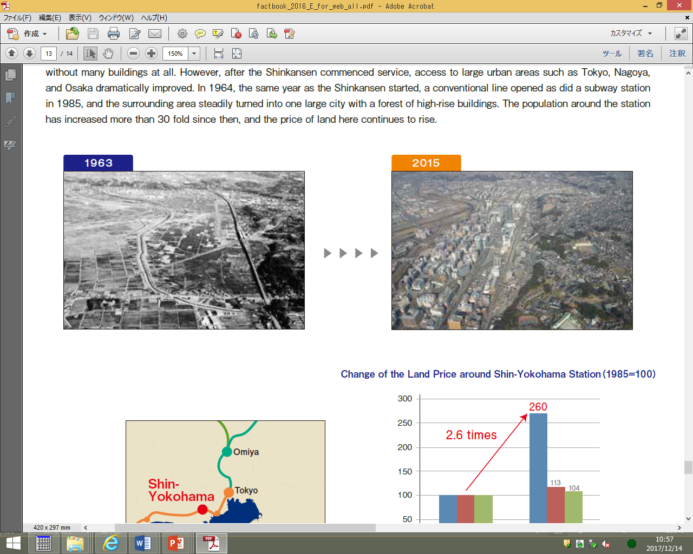
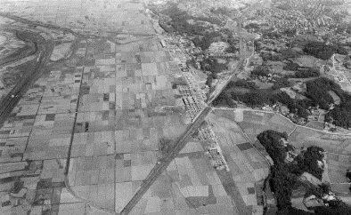
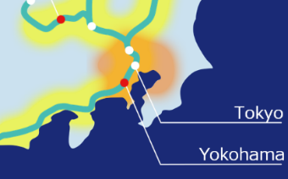
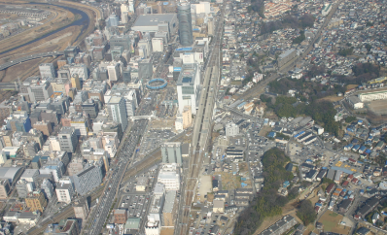
Part2: The impact Shinkansen has had on economic growth in urban areas
Shin-yokohama Station
New Station opened
in 1964
25km from Tokyo
Shin-
Daily Passengers
Shinkansen
Conventional(JR)
1964 / 2018
1964 / 2018
Notes:
https://statresearch.jp/traffic/train/stations/passengers_station_133_216.html
新幹線は
https://www.jrta.co.jp/pdf/JR_MEDIA_GUIDE_2018_all.pdf

Slide 8
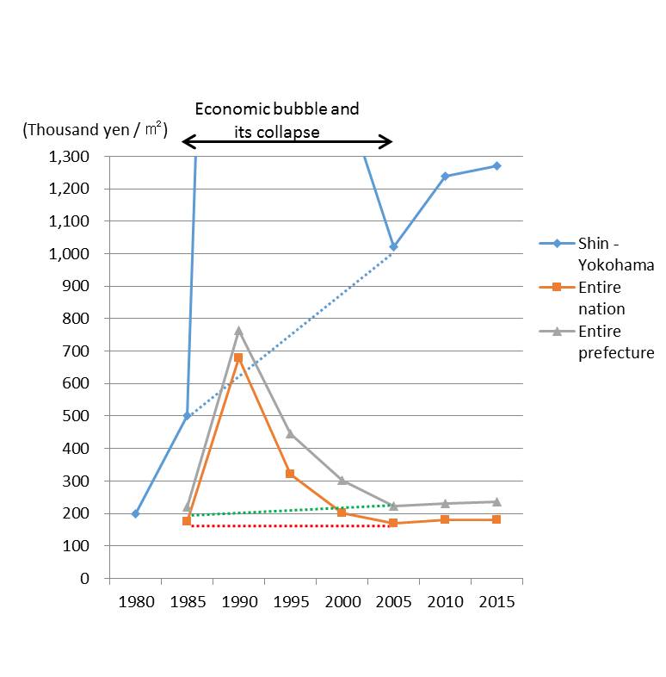
Part2: The impact Shinkansen has had on economic growth in urban areas
Changes in land prices around
Shin-Yokohama station
Population growth of Shin-Yokohama
Population of Shin-Yokohama block 1 - 3
Source: City of Yokohama
Notes:
データの連続性は不明も、2015年以降は12月末時点のデータを以下から引用（新横浜1～3丁目）
https://www.city.yokohama.lg.jp/city-info/yokohamashi/tokei-chosa/portal/jinko/chocho/juki/

Slide 9
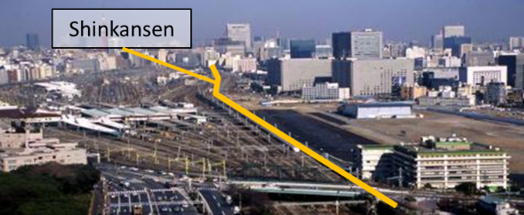
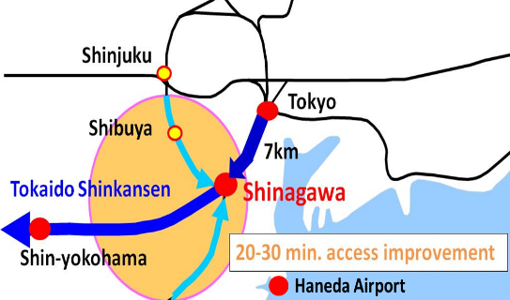
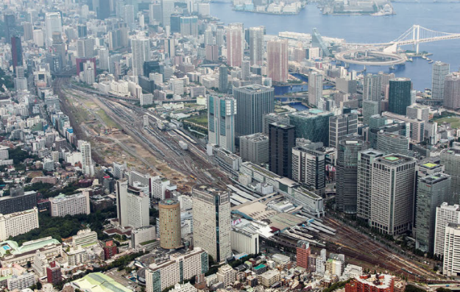
Part2: The impact Shinkansen has had on economic growth in urban areas
1995
Shinagawa Station
Conventional rail station opened in 1886
Shinkansen station opened in 2003
2017
Former Site of Shinagawa Depot Railway Yard
Shinkansen Shinagawa Station
(Future Chuo Shinkansen Station)
Notes:
・次に、品川駅開業による外部経済効果について紹介します。
・左上の写真は、品川駅開業から８年前の駅周辺の写真です。中央のオレンジの線が新幹線になりますが、その右側の「港南地区」は、以前新幹線の車両基地があった敷地で、何もない更地でした。
・下の写真は品川駅が開業した２００３年の同じ場所の写真になります。ご覧のとおり、わずか８年ほどで、何もなかった敷地にオフィスビルが林立しており、現在でも周辺地区では新たなビルの建設が続いています。
・右のグラフは、「港南地区」のオフィスの数と就業人口の推移を示しています。ご覧のとおり、駅開業以前と比べると棒グラフで示したオフィスの数は２倍以上に伸び、それに伴い折れ線グラフで示した就業人口は３倍以上に増加しています。
・品川駅では今後中央新幹線のターミナル部分の建設に加え、駅周辺の開発も予定されており、更なる発展が期待されています。

Slide 10
Part2: The impact Shinkansen has had on economic growth in urban areas
Daily passengers
Conventional Rail (JR)
Shinkansen
Notes:
https://statresearch.jp/traffic/train/stations/passengers_station_133_482.html
新幹線は
https://www.jrta.co.jp/pdf/JR_MEDIA_GUIDE_2018_all.pdf
右の表は経済センサス（活動調査）

Slide 11
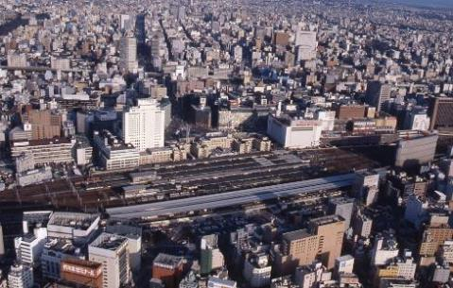
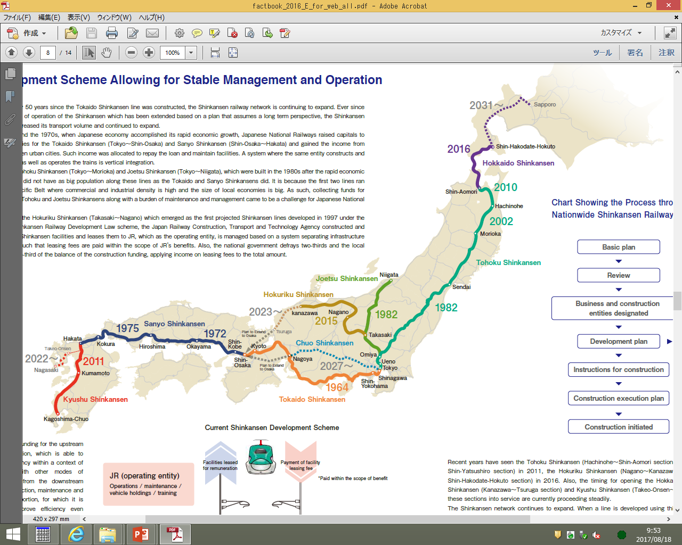
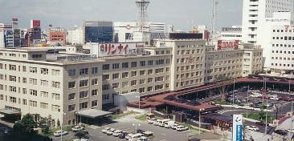
Part2: The impact Shinkansen has had on economic growth in urban areas
Nagoya Station
1992
Osaka
Tokyo
Nagoya
350km distance between Tokyo and Nagoya
Conventional rail station opened in 1872
Shinkansen station opened in 1964

Slide 12
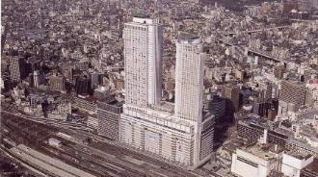
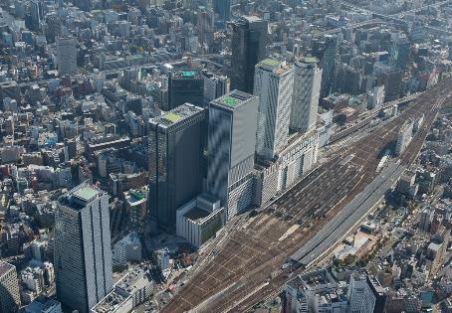
Part2: The impact Shinkansen has had on economic growth in urban areas
1999
JR Central Towers
(completed in 1999)
Midland Square
(completed in 2006)
2017
Lucent Tower
(completed in 2007)
Daily passengers
JP Tower Nagoya
(completed in 2015)
JR Gate Tower
(completed in 2017)
Notes:
名古屋駅の乗降者数は、annual report2018の乗車人員を2倍にして表示
在：146,000
幹：74,000

Slide 13
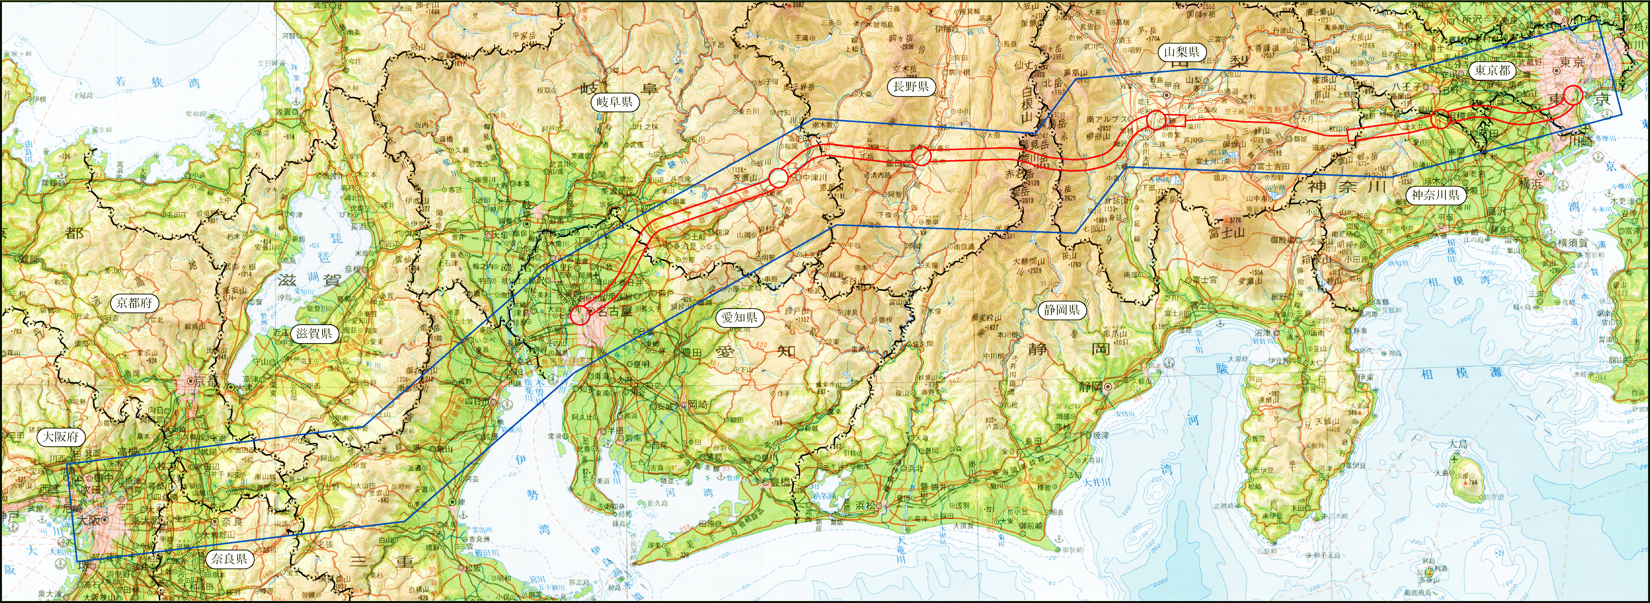
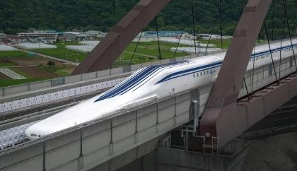
Part3: The technological investments being made by JR Central to commercialize the SCMAGLEV
Under Construction
(completion expected in 2027)
Tokyo
Chuo Shinkansen
Nagoya
306,020 people have ridden
SCMAGLEV has traveled more than 3,000,000 km
(As of end of Sep. 2019)
Osaka
Tokaido Shinkansen
 | Commercial speed | Distance and time required (by max. speed)
 |  | Tokyo-Nagoya | Tokyo-Osaka
Tokaido | 285 km/h | 342 km / 86 min. | 515 km /142 min.
Chuo | 500 km/h | 285 km / 40 min. | 438 km / 67 min.

Slide 14
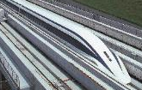
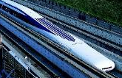

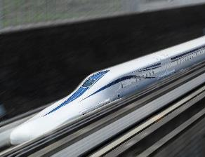
Part3: The technological investments being made by JR Central to commercialize the SCMAGLEV
Progress on the SCMAGLEV
June 1990 | JRC applies to the Minister of Transport for approval of the construction plan of the Yamanashi Maglev Line and gains approval
April 1997 | Running tests start on the Yamanashi Maglev Line
March 2000 | The Superconducting Magnetic Levitation Technological Practicality Evaluation Committee of the MLIT acknowledges that “there is potential from a technological standpoint that the technology could have practical applications”
July 2009 | The Evaluation Committee on MLIT acknowledges that “the technologies required for commercial services have been established from a comprehensive and systematic standpoint, and it is possible to move forward with detailing the specifications for commercial services and the technical standards”
April 2015 | JRC records the world speed record for a manned rail vehicle at 603 km/h
February 2017 | The Evaluation Committee of MLIT evaluates that “the technology development required for commercial lines was completed”
August 2020 | Running tests start using Series LO improved version

Slide 15
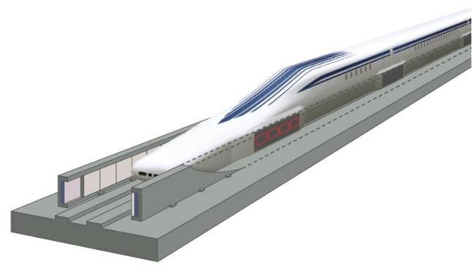
Part3: The technological investments being made by JR Central to commercialize the SCMAGLEV
Superconducting Magnets
Levitation and Guidance Coils
Emergency brake
Safety Control System
Propulsion Coils
Train position, etc.
Traffic Control System
Electric current for propulsion
Running profile
Drive Control System
Gap between the vehicle and the runway
S
N
100 mm

Slide 16
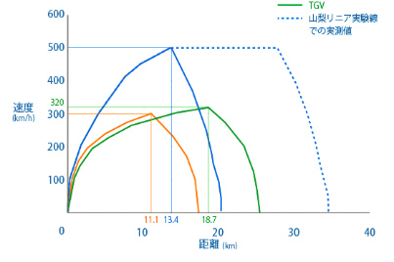
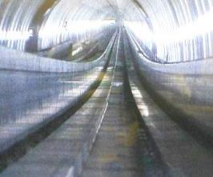
Part3: The technological investments being made by JR Central to commercialize the SCMAGLEV
Outstanding acceleration / deceleration
performance
Outstanding climbing performance
SCMAGLEV
SCMAGLEV
(actual train path
In Yamanashi)
500km/h (311mph)
40m
Speed
(km/h)
TGV
1000m
Shinakansen
N700A
Max. gradient = 4%
Distance (km)

Slide 17





Part4: The technical improvement of Shinkansen since 1964
Transition of Tokaido Shinkansen Rolling Stock
1964
1985
1992
1999
2007
2020
1st Generation
2nd Generation
・Steel carbody
・Conventional bogie
・DC motor drive
・Aluminum alloy carbody
・Bolsterless bogie
・Asynchronous motor drive
(VVVF control、Regenerative brake)
・Body inclining system
・Bogie vibration detection system
・Cruise control system
・Standard designed rollingstock
・Battery self-propulsion system
Series 0
Series 100
Series 300
Series 700
Series N700
N700S
Trainset
Weight
970t
925t
711t
708t
715t
713t
Operating
Speed
210km/h
220km/h
270km/h
270km/h
(Sanyo section: 285km/h)
285km/h
(Sanyo section:
300km/h)
285km/h
(Sanyo section:
300km/h)
New types of rollingstock have been introduced every 7-8 years since the establishment of JRC (after 1992)

Slide 18
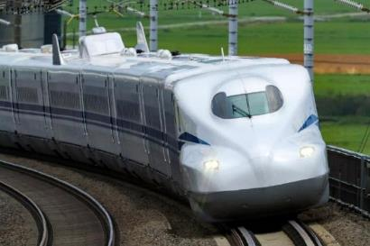
Part4: The technical improvement of Shinkansen since 1964
〇 Concept of N700S
1. Pursue further safe and reliable transportation
Shorten brake distance in the case of an earthquake etc.
2. Strengthen the ability of responding to emergencies
Realize the world’s first self-propulsion system for HSR, enhance security by installing
more on-board CCTV and emergency communication device, enable the use of toilets
even under long-term power outage
3. Strengthen competitiveness of the Tokaido Shinkansen
Improve riding comfort and quietness, enhance ride comfort by installing power outlets to all passenger seats etc.
4. Reduction of system total cost
Reduce system running cost
5. Realization of “standard designed rolling stock”, applicable to various alignments worldwide
Prove running performance of 16-cars (14M2T and 16M) and 8-cars (8M)

Slide 19
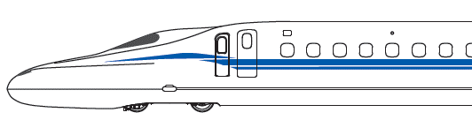
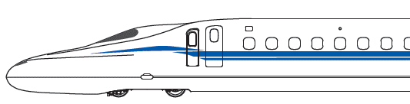
Part4: The technical improvement of Shinkansen since 1964
Battery-based Self-propulsion System
〇 Outline of the system
Ordinary operation
Power supply
Self-propelled operation
Power outage
Overhead cable
Pantograph
Overhead cable
Pantograph
Main
transformer
(MTr)
Auxiliary
power supply
Main
transformer
(MTr)
Auxiliary
power supply
Charging Power
Feeding Power
Motor
Main converter inverter (CI)
Lithium-ion battery
Motor
Main converter inverter (CI)
Lithium-ion battery
Charging power to the battery from the overhead cable
Supply power to traction from battery
〇 System usage
Tunnel
During extended power outage at the time of natural disasters, the system will avoid trains stopping inside tunnels and on bridges, and reach a safe location where passenger evacuation is easier.

Slide 20
Part4: The technical improvement of Shinkansen since 1964
Thanks to substantial downsizing and weight reduction, realized a low cost rolling stock
standardization which can be customized to demands overseas (e.g. Taiwan, Texas)
Cars | MT ratio | Train set configuration
16 | 14M2T (Tokaido Shinkansen)
 | 16M
12 | 10M2T (Taiwan)
8 | 8M (Texas)
6 | 6M (Nagasaki (Plan))
3M1T
4M
4M
3M1T
4M
4M
4M
4M
3M1T
4M
3M1T
4M
4M
3M
3M
- Trainset arrangement is flexibly adjustable (trainset length, capacity)
- MT ratio can be customized in accordance with the local demand
- Capable of applying reliable and high quality equipment identical to the Tokaido Shinkansen

Slide 21
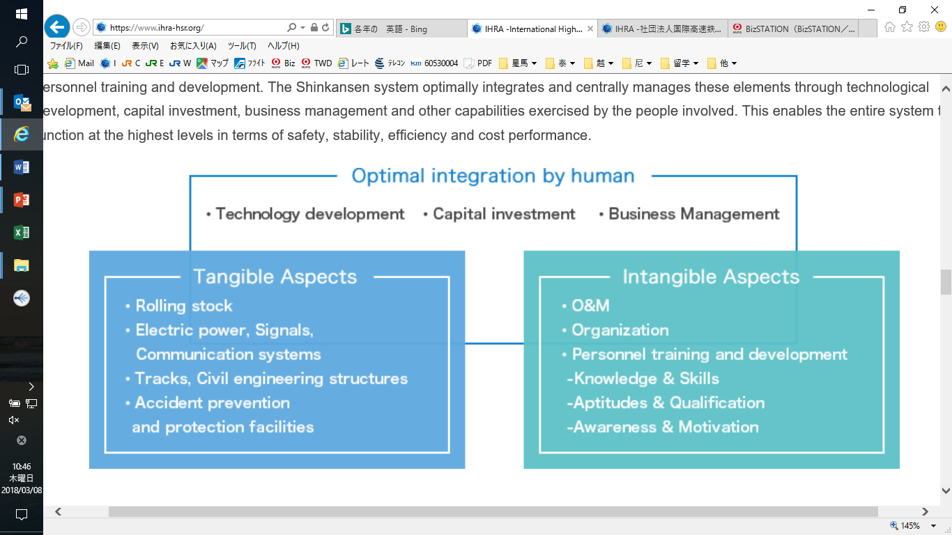
Part4: The technical improvement of Shinkansen since 1964
Total System Approach
Employing people's capabilities to centrally manage the tangible and intangible elements comprising the system makes it possible to integrate the entire system so as function at the highest level.

Slide 22
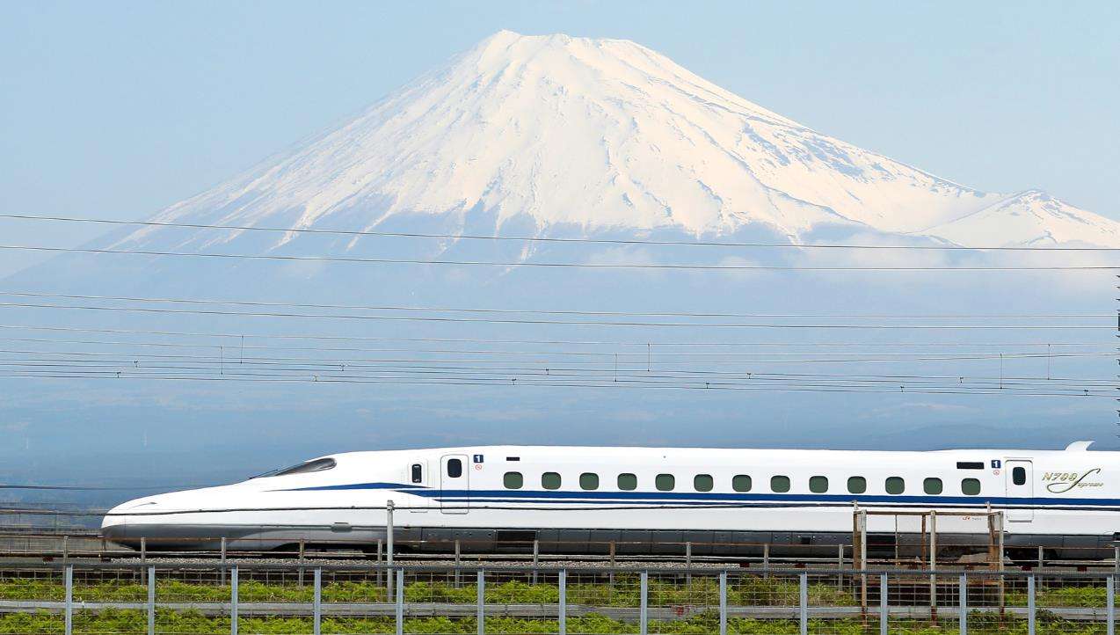
Shinkansen is not only Transportation
It is Transformation
＠2020IHRA

